Slide 1
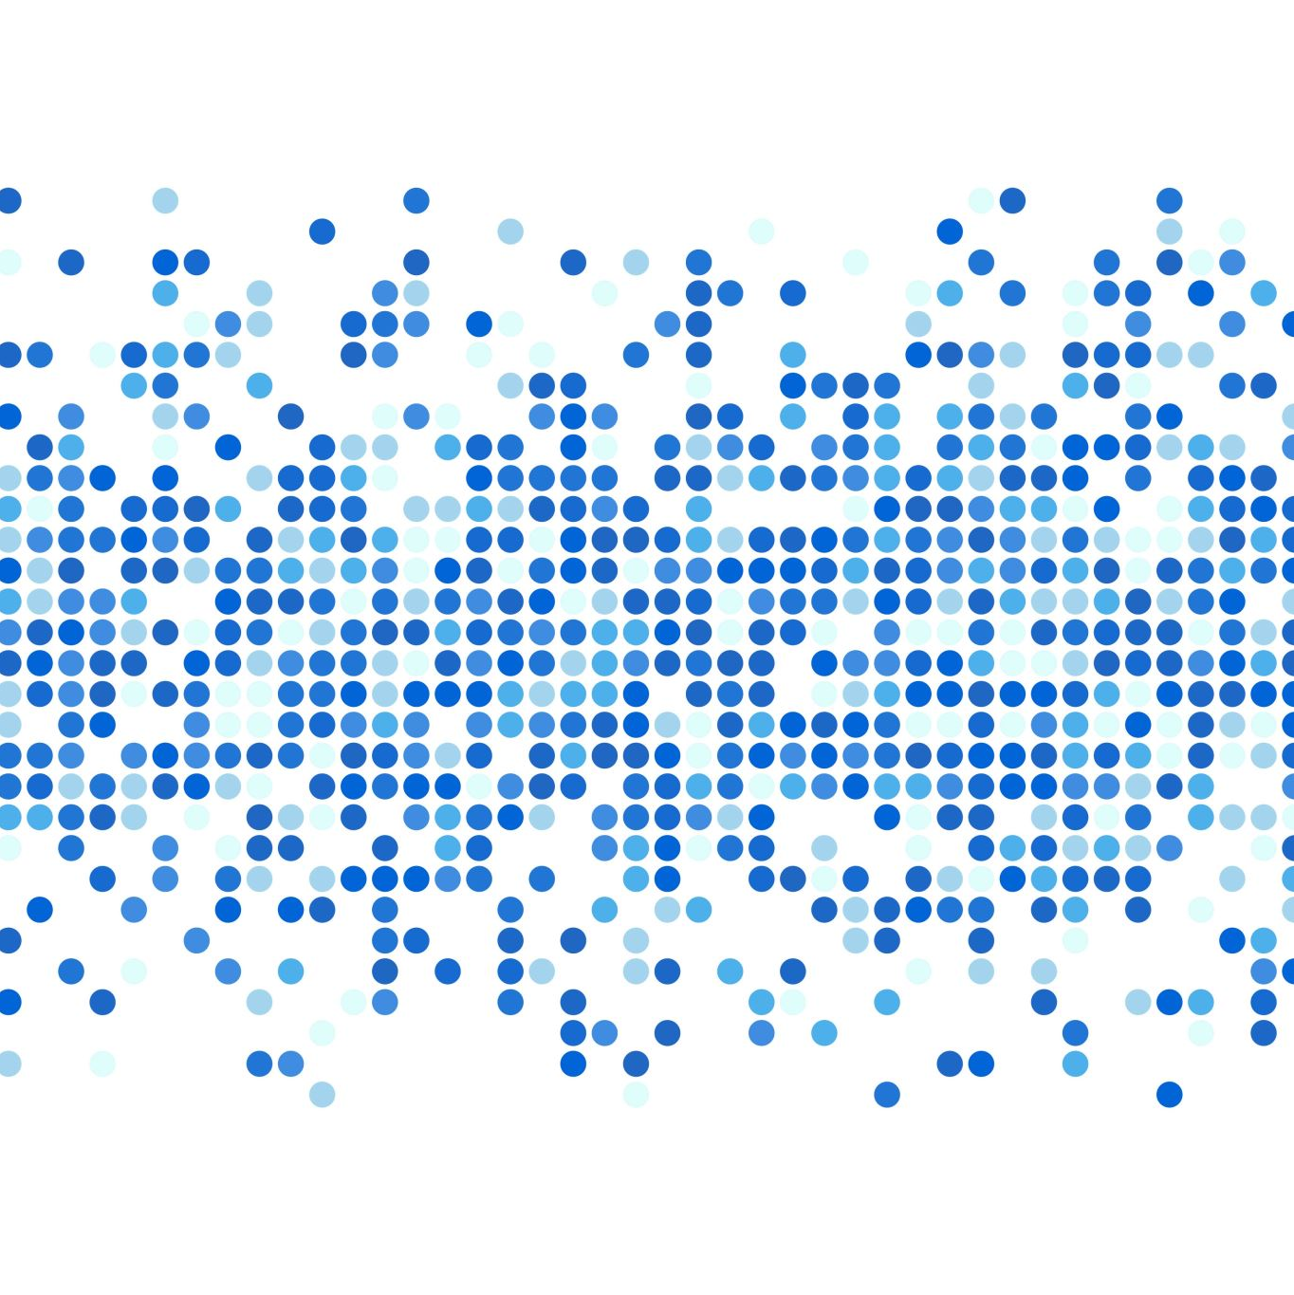
Mini-Project 1: The Budgeted Maximum Coverage Problem
Algorithm Written By:
Alejandro Ardon

Slide 2
The Problem
A city would like to collect pollution data using a device consumers can carry with them. The city will then purchase the data collected from these devices for an amount determined by the consumers. The city needs an algorithm that will maximize the coverage of these devices while staying within a given budget.

Slide 3
The Algorithm
The algorithm works by selecting the consumer in range of the most consumers for the cheapest price (# of covered consumers / cost). The algorithm then repeats this process until it can no longer collect data while staying within budget.

Slide 4
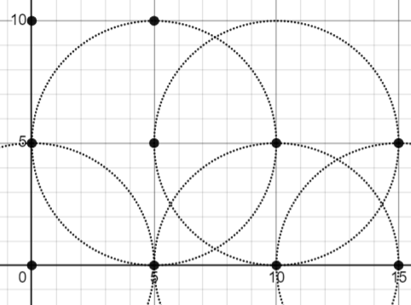
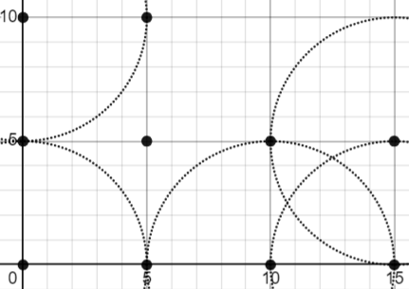

Algorithm VS Random Selection VS Greedy Uniform Spread
Radius = 5
Budget = $10
Algorithm
Greedy (cost)
Random Selection

Slide 5
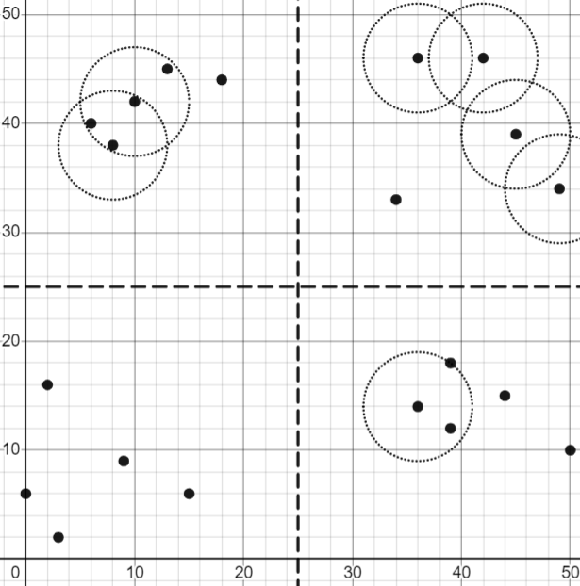

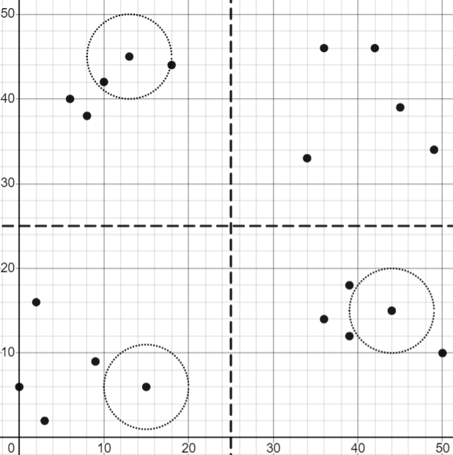
Algorithm VS Random Selection VS Greedy Random “Neighborhood” Spread
Radius = 5
Budget = $15
Algorithm
Greedy (cost)
Random Selection

Slide 6
Conclusion
While the Greedy Algorithm alone isn’t terrible, The new algorithm is clearly superior, as it covers a greater area at the same or lesser cost

